Slide 1
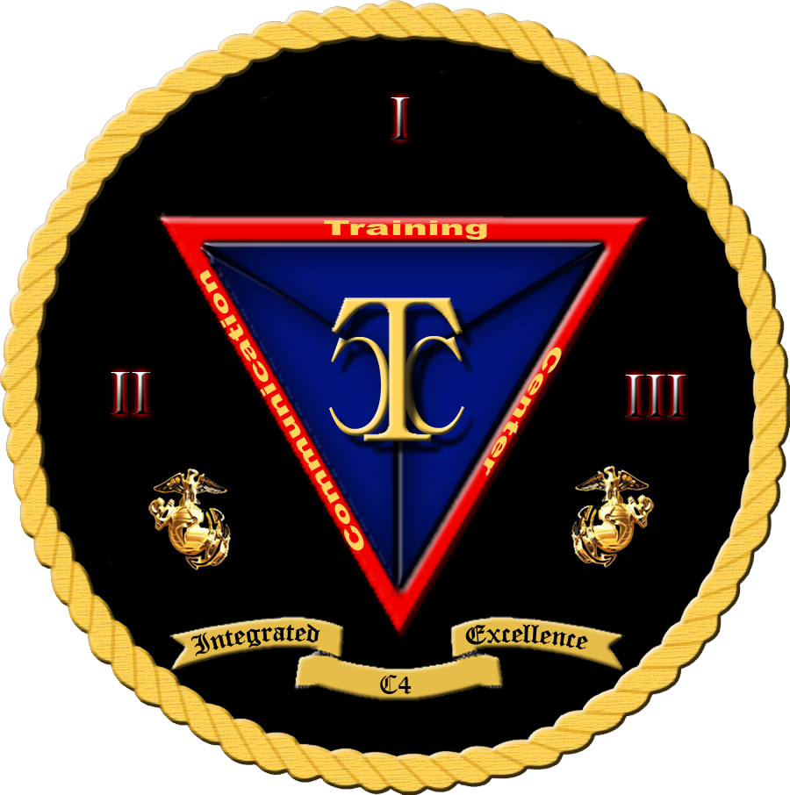
Security+
Exam SY0-601
Chapter 22
Implementing Cloud Security
Notes:
Gain Attention

Slide 2
Chapter 22 (Domain 3.6) Learning Objectives
Apply cybersecurity solutions to the cloud.
Cloud security controls
High availability across zones
Resource policies
Secrets management
Integration and auditing
Storage
Permissions
Encryption
Replication
High availability
Network
Virtual networks
Public and private subnets
Segmentation
API inspection and integration
Compute
Security groups
Dynamic resource allocation
Instance awareness
Virtual awareness
Cloud (VPC) endpoint
Container security
Solutions
CASB
Application security
Next-generation secure web gateway (SWG)
Firewall considerations in a cloud environment
Cost
Need for segmentation
Open systems interconnection (OSI) layers
Cloud native controls vs third-party solutions

Slide 3
Cloud Security Controls
Cloud security controls are a shared issue—one that is shared between the user and the cloud provider.
Depending on your terms of service with your cloud provider, you will share responsibilities for software updates, access control, encryption, and other key security controls.
What is important to remember is to define the requirements up front and have them written into the service agreement with the cloud provider, because unless they are part of the package, they will not occur.

Slide 4
High Availability Across Zones
Cloud computing environments can be configured to provide nearly full-time availability.
This is done using redundant hardware and software that make the system available despite individual element failures.
When something experiences an error or failure, the failover process moves the processing performed by the failed component to the backup component elsewhere in the cloud.
This process is transparent to users as much as possible, creating an image of a high availability system to users.
Architecting these failover components across zones provides high availability across zones.

Slide 5
Resource Policies
Cloud-based resources are controlled via a set of policies.
This is basically your authorization model projected into the cloud space.
Different cloud vendors have different mechanisms to define the groups, types of resources allowed, and assignments by location or compartment.
The integration between the enterprise identity access management (IAM) system and the cloud-based IAM system is a configuration element of utmost importance when setting up the cloud environment.
The policies set the permissions for the cloud objects. Once the resource policies from the enterprise are extended into the cloud environment and set up, they must be maintained.
The level of integration between the cloud-based IAM system and the enterprise-based IAM system will determine the level of work required for regular maintenance activities.

Slide 6
Secrets Management
Data that is in the cloud is still data that is on a server and is therefore, by definition, remotely accessible.
It is important to secure the data using encryption. A common mistake is to leave data unencrypted on the cloud.
Secrets management is the term used to denote the policies and procedures employed to connect the IAM systems of the enterprise and the cloud to enable communication with the data.
Secrets management is an important aspect of maintaining cloud security.

Slide 7
Integration and Auditing
The integration of the appropriate level and quantity of security controls is a subject that is always being audited.
Are the controls appropriate?
Are they placed and used correctly?
Most importantly, are they effective?
These are standard IT audit elements in the enterprise.
The moving of computing resources to the cloud does not change the need or intent of audit functions.

Slide 8
Integration and Auditing
Cloud computing audits have become a standard as enterprises are realizing that unique cloud-based risks exist with their data being hosted by other organizations.
To address these risks, organizations are using specific cloud computing audits to gain assurance and to understand the risk of their information being lost or released to unauthorized parties.
Two sets of requirements:
Understanding of the cloud security environment as deployed
Data security requirements
The result is that cloud computing audits can be in different forms, such as SOC 1 and SOC 2 reporting, HITRUST, PCI, and FedRAMP.

Slide 9
Storage
Cloud-based data storage was one of the first uses of cloud computing.
Defined permissions to access and modify data
Protect data from unauthorized access
Encryption
The replication of data across multiple different systems as part of the cloud deployment and the aspects of high availability elements of a cloud environment can complicate the securing of data.

Slide 10
Permissions
Permissions for data access and modifications are handled in the same manner as in an on-premises IT environment.
Identity access management (IAM) systems are employed to manage the details of who can do what with each object.
The key to managing this in the cloud is the integration of the on-premises IAM system with the cloud-based IAM system.

Slide 11
Encryption
Encryption of data in the cloud is one of the foundational elements to securing one’s data when it is on another system.
Data should be encrypted when stored in the cloud, and the keys should be maintained by the enterprise, not the cloud provider.
Keys should be managed in accordance with the same level of security afforded keys in the enterprise.

Slide 12
Replication
Data may replicate across the cloud as part of a variety of cloud-based activities.
From shared environments to high availability systems, including their backup systems, data in the cloud can seem to be fluid, moving across multiple physical systems.
This level of replication is yet another reason that data should be encrypted for security.
The act of replicating data across multiple systems is part of the resiliency of the cloud, in that single points of failure will not have the same effects that occur in the standard IT enterprise.
Therefore, this is one of the advantages of the cloud.

Slide 13
High Availability
High availability storage works in the same manner as high availability systems described earlier in the chapter.
Having multiple different physical systems working together to ensure your data is redundantly and resiliently stored is one of the cloud’s advantages.
What’s more, the cloud-based IAM system can use encryption protections to keep your data secret, while high availability keeps it available.

Slide 14
Network
Cloud-based systems are made up of machines connected using a network.
Typically, this network is under the control of the Cloud Service Provider (CSP).
While you may be given network information, including addresses, the networks you see might actually be encapsulated on top of another network that is maintained by the service provider.
In this fashion, many cloud service providers offer a virtual network that delivers the required functions without providing direct access to the actual network environment.

Slide 15
Virtual Networks
Most networking in cloud environments is via a virtual network operating in an overlay on top of a physical network.
The virtual network can be used and manipulated by users, whereas the actual network underneath cannot.
This gives the cloud service provider the ability to manage and service network functionality independent of the cloud instance with respect to a user.
The virtual network technology used in cloud environments can include software-defined networking (SDN) and network function virtualization (NFV) as elements that make it easier to perform the desired networking tasks in the cloud.

Slide 16
Public and Private Subnets
There is typically a need for public-facing subnets, where the public/Internet can interact with servers, such as mail servers, web servers, and the like.
There is also a need for private subnets, where access is limited to specific addresses, preventing direct access to secrets such as data-stores and other important information assets.
The cloud comes with the capability of using both public-facing and private subnets; in other words, just because something is “in the cloud” does not change the business architecture of some having machines connected to the Internet and some not.
“In the cloud” means that the Internet is used for all access.
However, in the case of private subnets, the cloud-based IAM system can determine who is authorized to access which parts of the cloud’s virtual network.

Slide 17
Segmentation
Segmentation is the network process of separating network elements into segments and regulating traffic between the segments.
Creates security barriers for unauthorized accessors through the inspection of packets as they move from one segment to another.
Can be done multiple way: MAC tables, IP tables, tunnels, firewalls, secure web gateways, VLANs.
The ultimate in segmentation is the zero-trust environment, where micro segmentation is used to continually invoke the verification of permissions and controls.
Can be performed in the cloud

Slide 18
API Inspection and Integration
APIs are software interfaces that allow various software components to communicate with each other.
Because of the nature of cloud environments, accepting virtually all requests across the web, there is a need for verifying information before it can be used.
Next-generation secure web gateway - analyzes information transfers at the application layer to verify authenticity and correctness.
Content inspection refers to the examination of the contents of a request to an API by applying rules to determine whether a request is legitimate and should be accepted.
API content inspection is an active measure to prevent errors from propagating through a system

Slide 19
Compute
The compute aspects of a cloud system have the same security issues as a traditional IT system; in other words, the fact that a compute element is in the cloud does not make it any more or less secure.
What has to happen is that security requirements need to be addressed as data comes and goes from the compute element.

Slide 20
Security Groups
Security groups are composed of the set of rules and policies associated with a cloud instance.
These rules can be network rules, such as rules for passing a firewall, or they can be IAM rules with respect to who can access or interact with an object on the system.
Security groups are handled differently by each cloud service provider, but in the end, they provide a means of managing permissions in a limited granularity mode.
The end the objective is to place users into groups rather than to perform individual checks for every access request.
This is done to manage scalability, which is one of the foundational elements of cloud computing.

Slide 21
Dynamic Resource Allocation
A cloud-based system provides scalable, reliable computing in a cost-efficient manner.
Having a system whose resources can grow and shrink as the compute requirements change, without the need to buy new servers, expand systems, and so on, is one of the primary advantages of the cloud.
Cloud service providers manage this using dynamic resource allocation software that monitors the levels of performance.
In accordance with the service agreement, they can act to increase resources incrementally as needed.

Slide 22
Instance Awareness
Just as enterprises have moved to the cloud, so have attackers.
Command-and-control networks can be spun up in cloud environments, just as they are on real enterprise hardware.
Instance awareness is the name of a capability that must be enabled on firewalls, secure web gateways, and cloud access security brokers (CASBs) to determine if the next system in a communication chain is legitimate or not.
This is a relatively new and advanced feature, but one that is becoming increasingly important to prevent data disclosures and other issues from integrating cloud apps with unauthorized endpoints.

Slide 23
Virtual Private Cloud (VPC) Endpoint
A virtual private cloud endpoint allows connections to and from a virtual private cloud instance.
VPC endpoints are virtual elements that can scale. They are also redundant and typically highly available.
A VPC endpoint provides a means to connect a VPC to other resources without going out over the Internet.
View it as a secure tunnel to directly access other cloud-based resources without exposing the traffic to other parties.
VPC endpoints can be programmable to enable integration with IAM and other security solutions, enabling cross-cloud connections securely.

Slide 24
Container Security
Container security is the process of implementing security tools and policies to ensure your container is running as intended.
Allows applications and their dependencies to be packaged together into one operational element.
Commonly called a manifest, can be version-controlled, deployed, replicated, and managed across an environment.
Can contain all the necessary OS elements for an application to run; they can be considered self-contained compute platforms.
Security can be designed into the containers, as well as enforced in the environment in which the containers run.
Running containers in cloud-based environments is a common occurrence because the ease of managing and deploying the containers fits the cloud model well.
Most cloud providers have container-friendly environments that enable the necessary cloud environment security controls as well as allow the container to make its own security decisions within the container.

Slide 25
Solutions
Cloud security solutions are similar to traditional IT security solutions in one simple way: there is no easy, magic solution.
Security is achieved through multiple actions designed to ensure the security policies are being followed.
Whether in the cloud or in an on-premises environment, security requires multiple activities, with metrics, reporting, management, and auditing to ensure effectiveness.
With respect to the cloud, some specific elements need to be considered, mostly in interfacing existing enterprise IT security efforts with the methods employed in the cloud instance.

Slide 26
CASB
A Cloud Access Security Broker (CASB) is a security policy enforcement point that is placed between cloud service consumers and cloud service providers to manage enterprise security policies as cloud-based resources are accessed.
Can be an on-premises or cloud-based item; the key is that it exists between the cloud provider and customer connection, thus enabling it to mediate all access.
Enterprises use CASB vendors to address cloud service risks, enforce security policies, and comply with regulations.
They require an investment in the development of appropriate strategies in the form of data policies that can be enforced as data moves to and from the cloud.

Slide 27
Application Security
When applications are provided by the cloud, application security is part of the equation.
If the customer has the responsibilities for securing the applications, then the issues are the same as in the enterprise.
If the cloud service provider is responsible, there can be economies of scale, and the providers have the convenience of having their own admins maintain the applications.
However, with that comes the cost, and the issues of auditing to ensure it is being done correctly.

Slide 28
Next-Generation Secure Web Gateway (SWG)
A Next-generation Secure Web Gateway (SWG) is a network security service located between the users and the Internet.
SWGs work by inspecting web requests against company policy to ensure malicious applications and websites are blocked and inaccessible.
An SWG solution includes essential security technologies such as URL filtering, application control, data loss prevention, antivirus, and HTTPS inspection rolled into a comprehensive service to deliver strong web security.
Secure web gateways and next-generation firewalls (NGFWs) are similar because they both provide advanced network protection and are able to identify friendly versus malicious traffic.

Slide 29
Firewall Considerations in a Cloud Environment
Firewalls are needed in cloud environments in the same manner they are needed in traditional IT environments.
In cloud computing, the network perimeter has essentially disappeared; it is a series of services running outside the traditional IT environment and connected via the Internet.
To the cloud, the user’s physical location and the device they’re using no longer matter.
The cloud needs a firewall blocking all unauthorized connections to the cloud instance.
In some cases, this is built into the cloud environment; in others, it is up to the enterprise or cloud customer to provide this functionality.

Slide 30
Cost
The first question on every manager’s mind is cost.
There are cloud environments that are barebones and cheap, but they also don’t come with any built-in security functionality, such as a firewall, leaving it up to the customer to provide.
Therefore, this needs to be included in the cost comparisons to cloud environments with built-in firewall functionality.
The cost of a firewall is not just in the procurement but also the deployment and operation.
And all of these factors need to be included, not only for firewalls around the cloud perimeter, but internal firewalls used for segmentation as well.

Slide 31
Cloud Native Controls vs. Third-Party Solutions
When one is looking at cloud security automation and orchestration tools, there are two sources.
Provided by the cloud service provider
cloud-native controls vary by provider and by specific offering that an enterprise subscribes to as part of the user agreement and service license.
Third-party tools
The customer can license and deploy in the cloud environment.

